Slide 1

TEAM FRONT-END Development

Slide 2

PROJECT TOPIC:- AMAZON CLONE

Slide 3






AGENDA To Provide a Variety of Features for Customers in one place so that they can use these features according to their convenience without going anywhere and they can also see Product Reviews and Rating and plan to buy products accordingly in just few Clicks

Slide 4

PROJECT OVERVIEW
As We Know Clone is a Replica of an Original having some or Many features same to the Real one, so in this clone, one can also experience the same navbar tags redirecting sections and one can open a few sections at the New Tab using the In-Build feature of Html target=“_main” and Each Box has its Own redirect tags associated with Image.

Slide 5


WHO ARE THE END USERS?
End users are customers, Retailers, and College students for their Collage Accessories such as laptops, Bags, and many more, Retailers for selling of their products efficiently without wastage of Product, and Customers for buying a Product at a reasonable Amount.

Slide 6
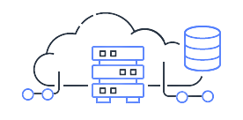
SOLUTION AND PRESENTATION
This Clone is made By use of Html, and CSS language and it has an In-Build Anchor tag for different sections of the Navbar such as Today’s Deal and Customer Services, Gift Ideas, Mini tv, and Prime which will redirect to their pages of Services and one can also sign-in their Own account with sign-in Anchor tag.

Slide 7



WOW IN SYSTEM
Flexibility.
Get access to a variety of goods at a reasonable amount.
Entertainment.
Many features in one place ex:-Amazon Kindle, Prime, Shopping, Mini tv, and many more.
Review of items.
Cost and time savings.
Easy Order and Return.
Variety in Payment Mode.

Slide 8
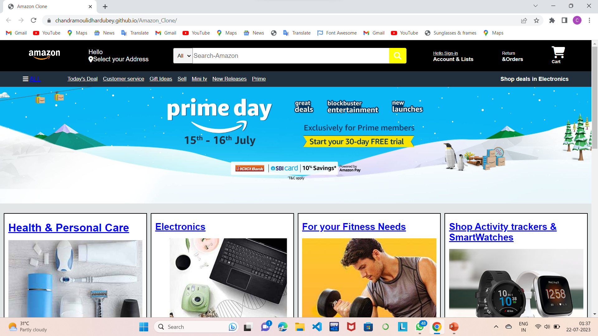
MODELLING

Slide 9








RESULTS
This is Amazon Clone inspired By Real Amazon Website ,this clone is made by Html and CSS and one can redirect to Amazon by clicking to its anchor tags through which one can sign in their Amazon account and shop items and get access to entertainment such as mini tv and prime.

Slide 10
Github Repositories:
Upload files · Amitkv123/AICTE-IBM-internshipProject (github.com)

Slide 11

THANK YOU..

